Slide 1
Map that App!
Oxford Academic Health Science Network
29 January 2014
Dr Anthony Hill, Senior Innovation Manager
Notes:
NHS Innovations South East is a dedicated team of professionals assisting staff within this Trust to develop and protect their ideas, or at the very least get recognition for their ideas.
The 15 strong team works closely with NHS Trusts across South East England and supports staff across a wide range of projects from training manuals to software and medical devices.
Several of these ideas are being to market allowing patients access to the technology.

Slide 2
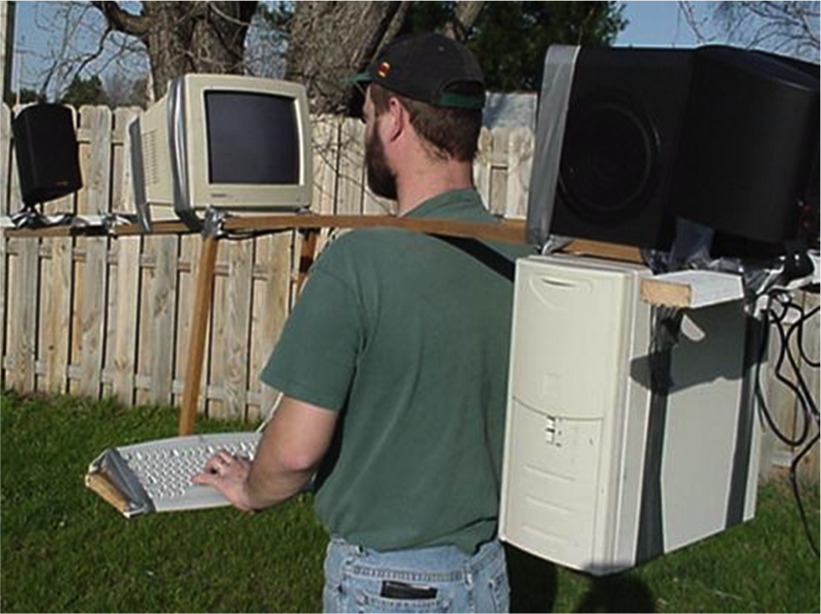

Slide 3
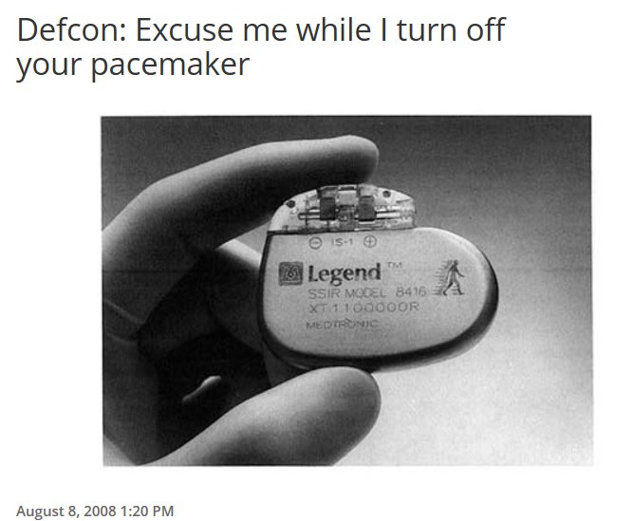
http://venturebeat.com/2008/08/08/defcon-excuse-me-while-i-turn-off-your-pacemaker/

Slide 4
Who are the “Digital Omnivores”?
79% medical students, 75% percent of junior doctors own a smartphone**
US smartphone use by doctors: 81% in 2010 to 91% in 2012. EU doctors: 44% in 2010 to 81% in 2012 in Europe‡‡
Main device - smartphone or tablet? Smartphone (77%), tablets up from 12% in 2012 to 23% in 2013*
Use of tablet PCs in healthcare (global) grew 27% in 2012 and is expected to increase to $1.7 billion for 2013‡
Source: *Adobe global 2013 Mobile Consumer Survey, ‡Kalorama Information, **BMC Medical Informatics and Decision Making Journal, ‡‡ EPC Health Media

Slide 5
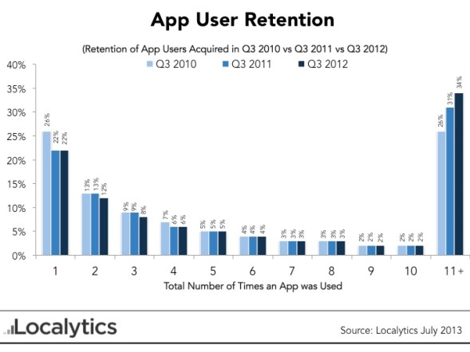
Proposed Agenda
App Stats!
Users downloaded 44 million mobile health (mHealth) apps downloads in 2012
142 million mHealth downloads predicted by 2016.*
Top mHealth publishers: 3 million free and 300,000 paid downloads in the USA on the iOS platform.
Wider mobile health market will reach $8 billion by 2018**
Source: *Juniper Research, **Global Data

Slide 6
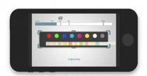
Wild West or Gold Rush?
Uptake and expectations are surging
97,000 mHealth applications listed on 62 full catalogue app stores
Many apps are unvalidated
Patient / consumer safety?
Medical Devices?
Data privacy issues?
Security?
Health App

Slide 7
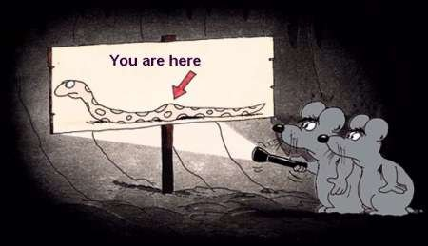
Health apps: where are we ?

Slide 8
*Subject to nature of mobile app
STAGE 1 – PRE-DEVELOPMENT
STAGE 2 – DESIGN & DEVELOPMENT
STAGE 3 – USER TESTING
STAGE 4 – STAKEHOLDER REVIEW
STAGE 5 – MEDICAL DEVICE PROCESS*
STAGE 6 – EXTERNAL DEPLOYMENT

Slide 10
Needs Assessment
What are your goals? Why develop a mobile app?
Competitive Analysis
(Validated Apps)
Am I “reinventing the Wheel”?
No
Go / No Go Decision
Project stakeholders? User Profiles? Public Patient Involvement needed at this stage? Hardware /platform preference?
Stakeholder /Target
Audience Analysis
Identify Suppliers / collaborators? Procurement process?
Internal Development or Outsourced?
Value Proposition?
Patient /organisational benefit ? Resources? Costs? Risks?
Commercialisation strategy?
Intellectual Property in app? – copyright in code, database rights, trademark branding
Sustainability? Ongoing support and costs?
Business Justification Case
No
Go / No Go Decision
Proceed to STAGE 2

Slide 11
STAGE 2 – DESIGN & DEVELOPMENT

Slide 12
Functionality? Data flows?
Public Patient Involvement?
USE CASES. Commercialisation route? Data & Device Security? Medical Device? (see stage 5)
Hardware Specifications?
User & System requirements
Wireframe Development
Early functions /user interface / website framework
Mocked up prototype screens permitting user interaction feedback
Screenshots
Code Generation
API Usage, App Store optimisation?
System Integration & testing
Linking mobile app into existing or new ICT infrastructure. Interoperability?
User Training
Proceed to STAGE 3

Slide 13
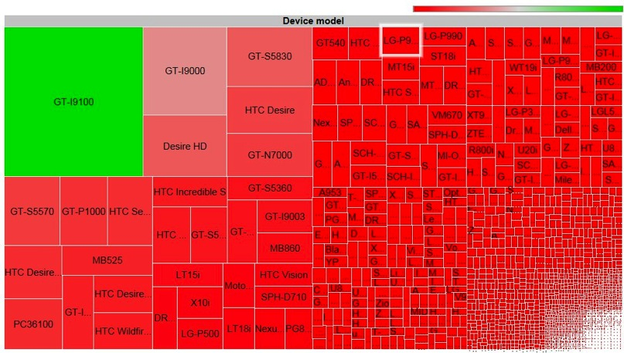
May 2012: Audit of Android fragmentation
Almost 4000 android devices involving 600 different brands
Source: http://opensignal.com/reports/fragmentation.php

Slide 14
Application Programming Interface (API) fragmentation
Version | Codename | API | Distribution
2.2 | Froyo | 8 | 1.30%
2.3.3 - | Gingerbread | 10 | 21.20%
2.3.7
3.2 | Honeycomb | 13 | 0.10%
4.0.3 - | Ice Cream Sandwich | 15 | 16.90%
4.0.4
4.1.x | Jelly Bean | 16 | 35.90%
4.2.x |  | 17 | 15.40%
4.3 |  | 18 | 7.80%
4.4 | KitKat | 19 | 1.40%
Data collected during a 7-day period ending on January 8, 2014.
Any versions with less than 0.1% distribution are not shown.
Source: Dashboard from
Developer.android.com

Slide 15
STAGE 3 – USER TESTING

Slide 16
Development
Complete? YES
Proceed to STAGE 4
User Testing
Refine Prototype
Development
Complete? NO
Back to STAGE 2
Usability? Performance? Hardware? Communications?
Contribution to technical file for CE marking
USER EXPERIENCE IS KEY!

Slide 17
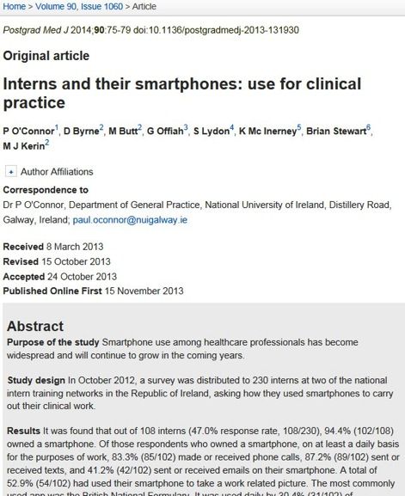

Slide 18
STAGE 4 – STAKEHOLDER REVIEW

Slide 19
Medical Device?
YES
Clinical Safety assessment?
Systems review?
Security review?
Quality check?
Proceed to STAGE 5
Internal Deployment
Within organisation*
Pass Reviews?
YES
Medical Device?
NO
*Does not require CE marking
at this stage
Proceed to STAGE 6
Stakeholder Review /
Clinical Validation
Pass Reviews?
NO
Back to STAGE

Slide 20
STAGE 5 – MEDICAL DEVICE PROCESS

Slide 21
Medical Devices Directive
Under clause 2(a) of the Medical Devices Directive, a medical device is defined as follows:
Includes any software, whether used alone or in combination, including that specifically for diagnostic and/or therapeutic purposes and necessary for its proper application, intended by the manufacturer to be used for human beings for the purpose of:
diagnosis, prevention, monitoring, treatment or alleviation of disease,
diagnosis, monitoring, treatment, alleviation of or compensation for an injury or handicap,
investigation, replacement or modification of the anatomy or of a physiological process,
Control of conception;

Slide 22
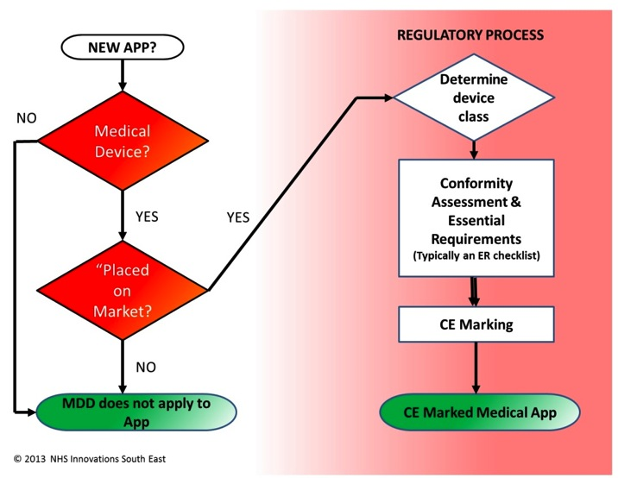

Slide 23
STAGE 6 – EXTERNAL DEPLOYMENT

Slide 24
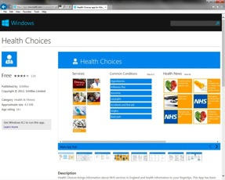
Deployment
App stores are a means of both selling and deploying mobile apps to targeted users
More NHS organisations are implementing mobile management solutions (MAM / MDM) to deploy and manage app access, and also mobile hardware.
NHS England has launched the NHS Health Apps Library, lifestyle apps that had been reviewed to ensure they were clinically safe.

Slide 25
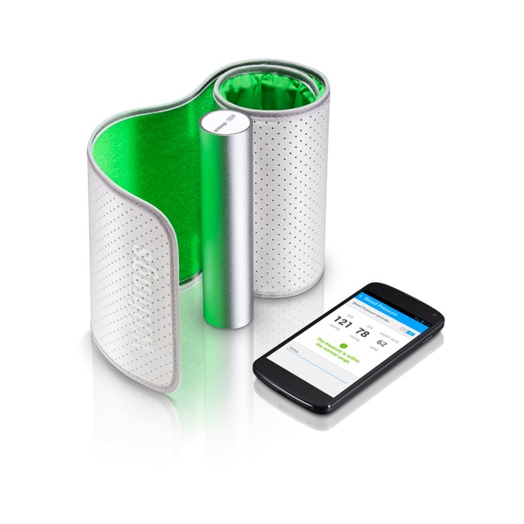
Commercialisation Approaches
Consumers are increasingly reluctant to pay for apps, particularly when so many apps are available and appear to be free.
App sustainability?
Free?
Worldwide mobile advertising is forecast to reach $24.5B by 2016*
In-app purchasing or freemium?
71% of App store revenue was from in-app purchases in 2013*
Paid
Users who plan to make app purchases from device*:
iPhone 69% Android 53% BlackBerry 35% Windows 32%
Source: *Localytics.com
Services or Product business stream

Slide 27
What we do
Thanks to Rhiannon Cox, Alan Kennedy and Chris Sawyer and Oxford AHSN
Accelerated Commercialisation of Non-Patent Intellectual Property Associated with Healthcare Apps
Event: 18th March 2014, Academic Centre, Maidstone & Tunbridge Wells NHS Trust
Details to follow at http://innovationssoutheast.nhs.uk

