Slide 1
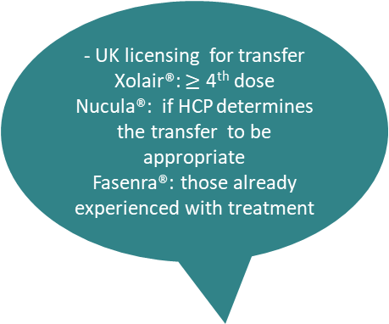
Transfer Timescale to Patient Self-Administration for sub-cutaneous Biologic Therapy
- Excellent engagement between patient and severe asthma team
- Adherent behaviour (appointments and treatment plans)
- Severe asthma centre set up providing oversight and monitoring
- Homecare nurse support available - Updated personalised action plan
- Suitable cold chain transport/storage
- Safe disposal of sharps
- Pregnancy requiring
closer patient monitoring
- Previous drug anaphylaxis / hypersensitivity reaction
- Ongoing face-to-face patient support and education required
- Maintenance oral corticosteroid step-down support requiring close monitoring and tests
- UK licensing for transfer
Xolair®: $≥$ 4th dose
Nucula®: if HCP determines the transfer to be appropriate
Fasenra®: those already experienced with treatment
- Non-adherent behaviour (appointments and
treatment plans)
- No cold chain delivery and/or storage
- Dexterity issues
- Patient declines home administration
LOWER RISK PATIENT HIGHER RISK PATIENT
Suitable for self-administration
Unsuitable for self-administration
Notes:
LEGEND

Slide 2
Legend
Fasenra (benrazlizumab), Nucula (mepolizumab), Xolair (omalizumab). Cinqaero (reslizumab) currently not suitable for patient self-administration; HCP = healthcare professional

