Slide 1
Maternity & Neonatal Shared Learning Event 27 March 2024
Evaluation Feedback : March 2024

Slide 2
Who attended the event
A variety of multi-professional colleagues and representatives from the MNVP
89 Registered
70 Attended the event

Slide 3
What value being part of this network brings to your role?
Feeling connected to a wider community all working towards the same aims.
Working together to improve care for patients and families.
Knowing that you have Trusts that are aiming for the same goals as you and working together to achieve these to improve quality of care for our babies and their families.
Being aware of the quality improvement work that is happening in our unit and the what areas need improvement.
Provides the opportunity to understand the work being done at other trusts across the network and to share ideas.

Slide 4
What was the biggest takeaway from the event…….
The progress that has been made to improve care with teams working together and shared learning within the network. Importance of ongoing work to reduce inequalities in healthcare.
The psychology safety and legal aspect.
Importance of maternal and neonatal shared decision making in counselling and management.
All the positive work that is going on around the network.
We are better off in this mess together!
The racial inequalities in medicine.
That we need to focus on staff wellbeing and support if we are going to able to improve safety and quality of care, and that we need to do work on bias and culture to make units safe psychologically and physically for patients and staff of all cultures and backgrounds.

Slide 5
What you had to say…….
“Excellent day - thank you!”
“Wide range of topics and examples of QI within clinical practice.
Evidence of how HIO added value and expertise”
“Thank you for a very informative and enjoyable day. It is always of immense benefit for the perinatal team to get together in this way. Meeting old friends is also a great pleasure!”
“Brilliantly organised and run as always.”
“Great Day would recommend!”
“Thank you - it was very thought provoking. Brilliant that its still going strong after 10 years!”
“I particularly enjoyed the session from the barrister as it generated really good discussion.”
Also “grey conversations”

Slide 6
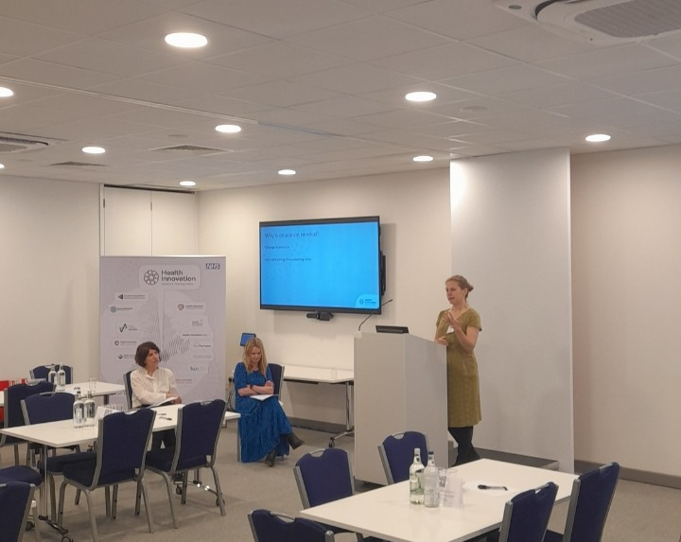
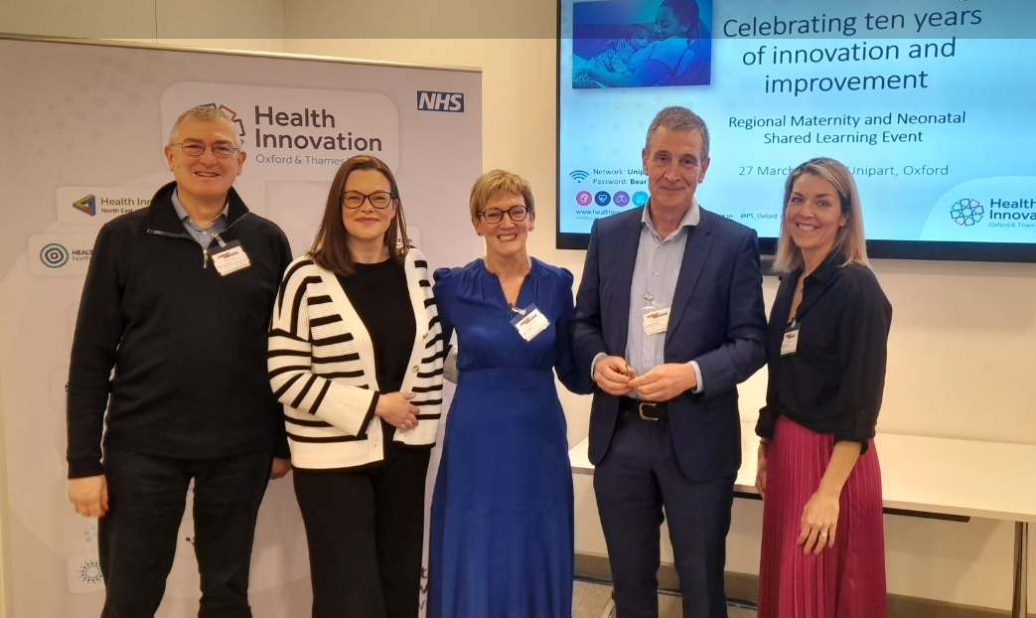
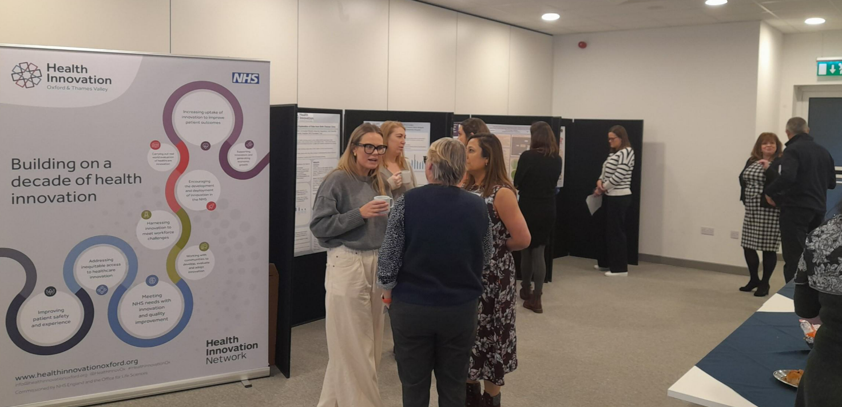
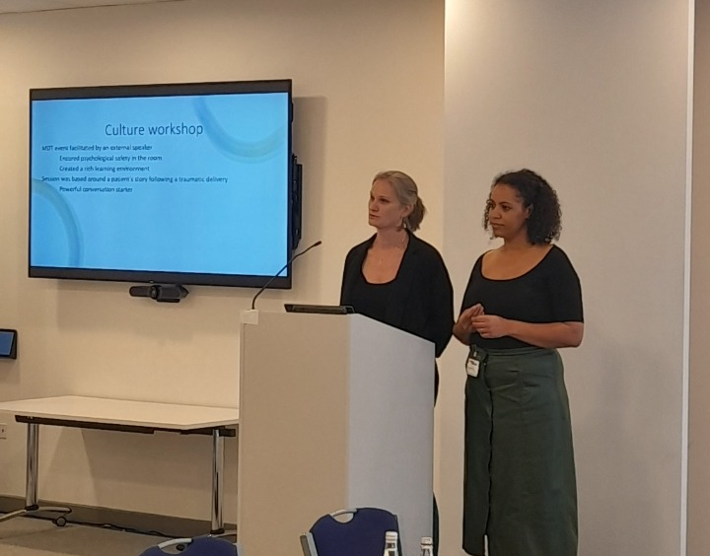
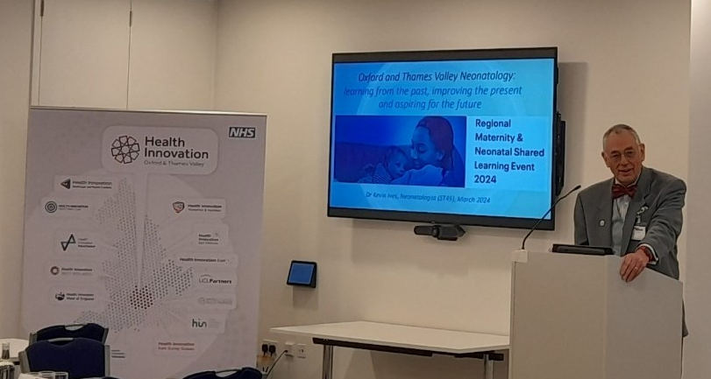
Take a look……

